Slide 1
Welcome to MGH!

Slide 2
Agenda
Why are we meeting?
Who is who?
Schedule / Survey walkthrough
Virtual Office Hours
Contracts, new hire paperwork
Housing
Q&A

Slide 3

Why are we meeting?

Slide 4
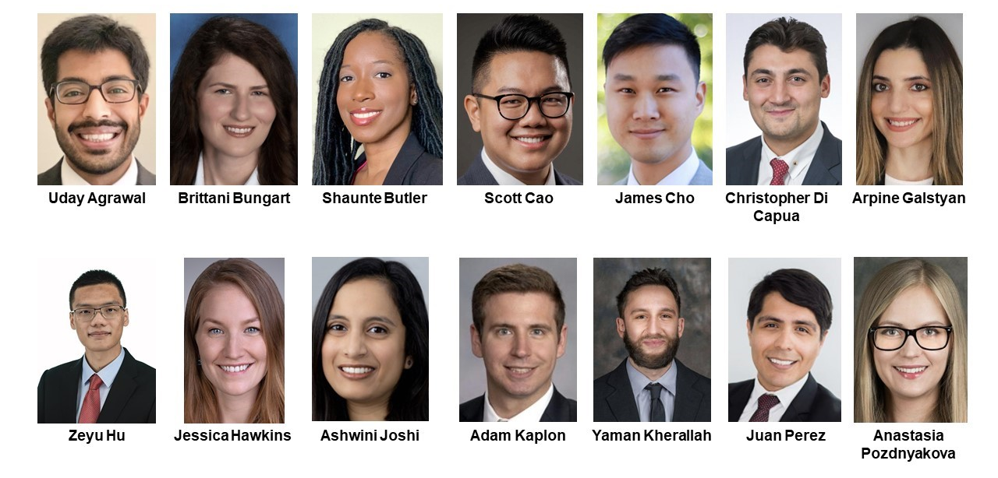
Who is who?

Slide 5
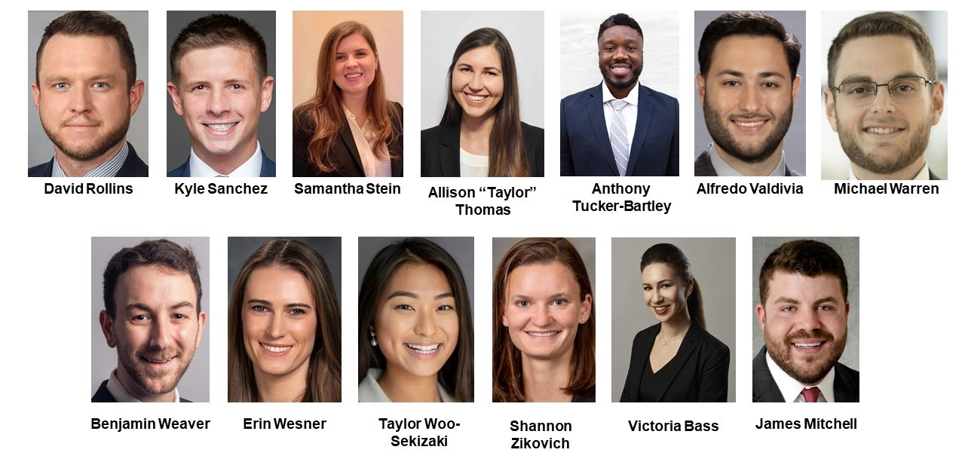
Who is who?

Slide 6
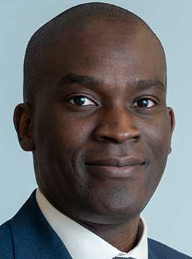
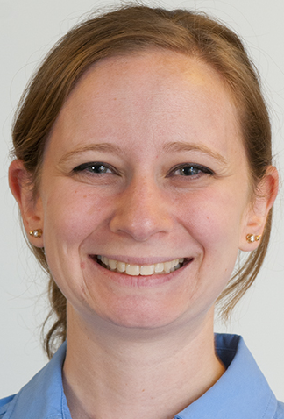

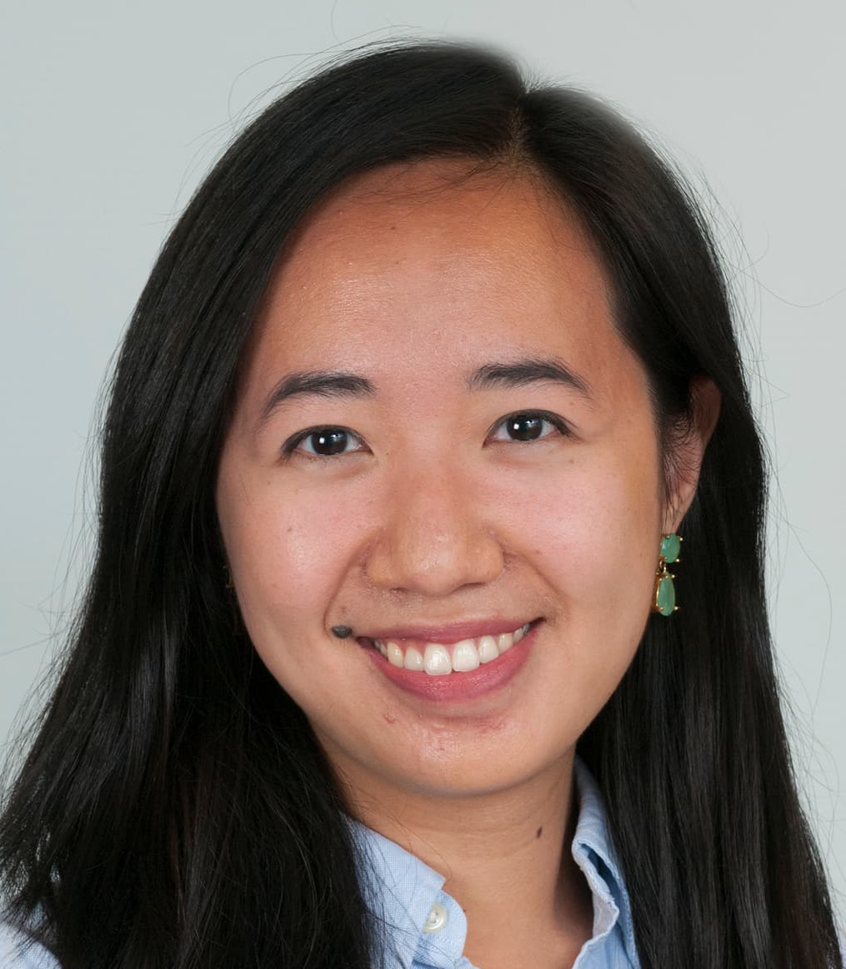

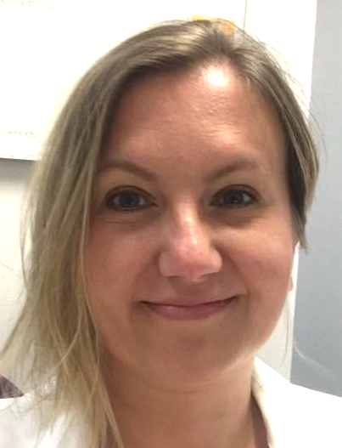


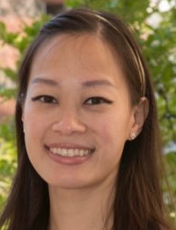
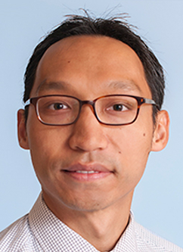

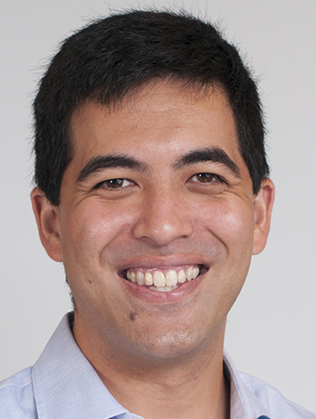
Who is who?
Seun
Aubrey
Elisa
Lucy
Maria
Alicja
Keith
Dan
Yvonne
Alex
Mike
Matt

Slide 7
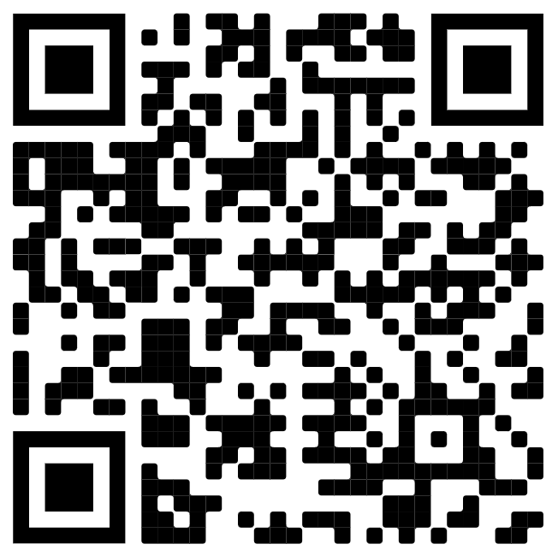
Social media post
We want to tag you on our match list post
https://bit.ly/392WhMo

Slide 8
Timeline to Intern year
March 19 Match!
March 26 Survey due
April 5 Credentialing paperwork due
April Look for housing
May Virtual social event TBD
June Move to Boston
June 14 First day of orientation
June 24 First clinical day of residency

Slide 9
Schedule overview
@ NWH
@ MGH
Back-stagger into anesthesia
Interns
Will have to make up some rotations later
Time (26 two-week blocks)
Notes:
52 weeks of intern year are broken up into 26 blocks, each two weeks long
Year has three major components: NWH rotations, MGH rotations, and Anesthesia rotations
Some schedules defer intern year rotations in order to start anesthesia training earlier, these schedules tend to have longer stretches of clinically rigorous rotations
Regardless of when anesthesia training starts, by about the end of PGY-2 year all residents will have had equal anesthesia training and opportunity for exposure to potential fellowship subspecialties
Notes for Dan
- Can we remove the “elective / selective” language here? Don’t want to bring it up yet and might be confusing

Slide 10
Rotations are arranged in 2- to 4-week blocks
Medicine
Surgery
Emergency
Anesthesia
Acute Pain
SICU
Selective
Elective
MGH + NWH
Bigelow (rotate through roles / share pts), Flex (your own list), NWH medicine & MICU
MGH +/- NWH
Care for patients with a senior, variable OR time
MGH +/- NWH
MGH
Ellison 4, care for up to 10 patients with a senior anesthesia resident
MGH
Paired with anesthesia resident and attending
MGH
Notes:
These are the major types of rotation to which you may be assigned for each block. Some rotations only come in 4-week (or 2-block) varieties
Intern year rotations that are assigned to you include:
Medicine training at MGH +/- NWH comes in several flavors: carry your own list on days, admit patients overnight, and MGH Bigelow (rotate through roles as a team)
Surgery training at MGH +/- NWH is daytime work carrying a list with a senior and operating when able
ED training occurs at MGH and for many interns also at NWH
ICU training occurs in MGH’s SICU where teams work together to care for ~10 patients, some interns will have extra ICU time at NWH, all can opt for more time though not all can get it
Everyone gets an early look at anesthesia training by working with the perioperative pain service (“Acute Pain”) for two weeks, interns can opt into more time as with ICU
In addition, there are two types of rotations that you have a hand in selecting… (next slide)
Notes to Dan:
Can we take out all of the (weeks) parts? It’s complicated and will draw too much attention in my opinion
For each of the Medicine, Surgery, ED, SICU, APS, Anesthesia bubbles: Can we make first line location (MGH vs MGH +/- NWH) and then 1-3 lines based on my descriptions?
Can we re-order the bubbles to put Elective and Selective at the bottom and take out the descriptions? We’ll talk about them in more depth on the next slide

Slide 11
Selectives and Electives
Selective: Clinically rigorous supplement to PGY-1 training
Elective: Opportunities for clinical or non-clinical development
Rotation catalog outlines schedules, service, and education focuses for each option
Notes:
Selectives and electives are 2-week rotations that interns use to help customize their clinical training
In general, selectives are more clinically rigorous while electives offer the opportunity for clinical or non-clinical development
It is worth noting that additional selective rotations beyond the required number can count as electives
Part of the survey that you were sent asks you to help us assign you to the selectives and electives that best fit your training goals
To help you with that we have created a catalog of available selectives and electives for you to review… (switch to catalog)

Slide 12
Self-Designed Electives
Formative, customized, rigorous experiences to enrich your development and long-term goals
Identification of a supervisor (prior to rotation start) and PD approval required
Examples could include:
- Other clinical experiences (e.g., Pediatrics)
- Original research
- Public health
- Pharmacy
- Medical ethics
- Quality & safety
- Didactic development

Slide 13
Survey walkthrough
Survey for walkthrough
DON’T USE THE LINK ABOVE (YOU WILL HAVE A CUSTOM LINK SENT TO YOUR EMAIL)

Slide 14
Virtual Office Hours
Dan https://harvard.zoom.us/j/5749049639 (Passcode: 1811)
3/24 (Wed) 7p-10p EST (or text for alt time 574-904-9639)
Matt Tung https://partners.zoom.us/j/83783751097
3/22 (Mon) 8-9am & 4-5pm EST 3/23 (Tue) 8-9am & 4-5pm EST
3/23 (Wed) 12-1pm EST 3/24 (Thu) 3-4pm EST
Alicja https://partners.zoom.us/j/85792657478
3/24 (Wed) 3-4pm EST 3/26 (Fri) 12-1pm EST
3/29 (Mon) 12-1pm EST 4/1 (Thu) 3-4pm EST

Slide 15
Paperwork
Contracts – in May, sign electronically
New Hire Paperwork for HR – part of the survey
Credentialing – complete electronically
Licensing – print, complete in BLACK ink, and mail
Credentialing and Licensing Paperwork is due April 5, 2021
Alicja will email instructions and will be available for questions during virtual office hours

Slide 16
Housing
https://ether.mgh.harvard.edu/wiki/index.php?title=Housing
Username: medstudent
Password: mgh1811

Slide 17
Timeline to Intern year
March 19 Match!
March 26 Survey due
April 5 Credentialing paperwork due
April Look for housing
May Virtual social event TBD
June Move to Boston
June 14 First day of orientation
June 24 First clinical day of residency
Question Time!
?

