Slide 1
Radiological Anatomy of the Lumbar Spine
Feb 21, 2019
Yi Zhang MD PhD
Dept. of Anesthesia, Critical Care and Pain Medicine
MGH

Slide 2
Some slides outlining different parts of spinal structures are adopted and modified from Spine Intervention Society lecture for teaching purpose. Please do not re-distribute.

Slide 3
Three views
Anterior-Posterior (AP) View
Lateral view
Contralateral oblique view
Two approaches
into the lumbar epidural/intrathecal space
Perpendicular interlaminar approach (coaxial technique)
Shallow angle paramedian approach

Slide 4
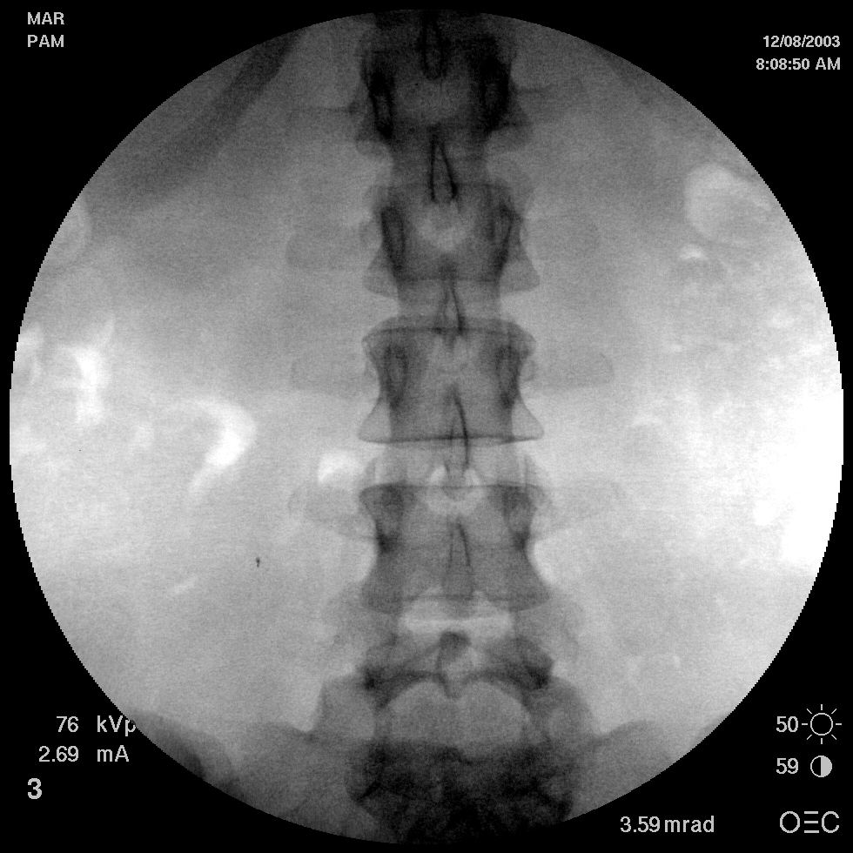
Reading An AP View

Slide 5
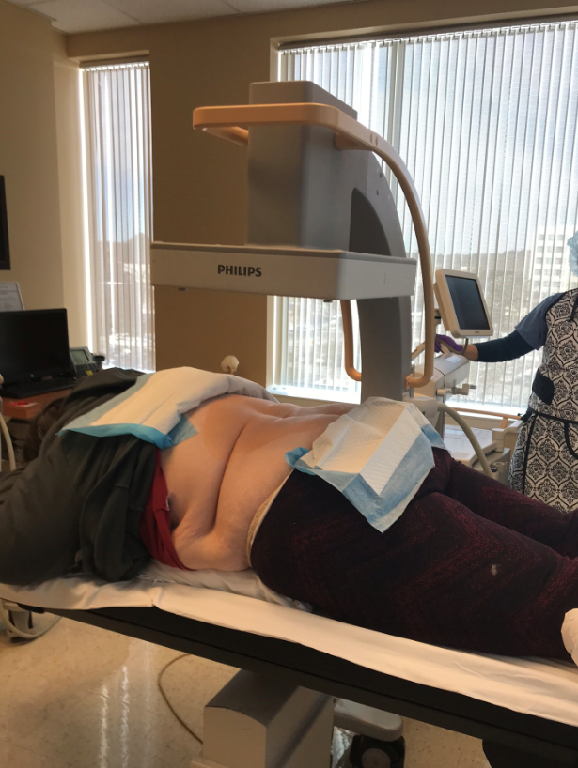
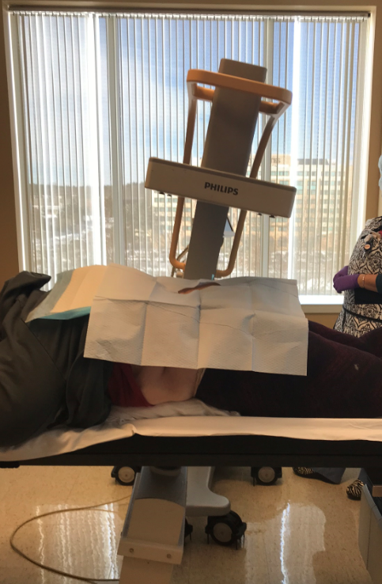
Getting the AP view

Slide 6
Let’s find these structures
pedicles
vertebral bodies
articular facets and zygapophysial joints
lateral margins of the lamina
superior margins of the lamina
inferior margins of the lamina
spineous processes
transverse processes.

Slide 7
1. PEDICLES

Slide 8
In order to make recognition of other parts of the vertebral column easier, it is best to start with the pedicles. These are the most distinctive elements that are clearly visible. They stand out as circles, like eyes looking at you.

Slide 9
L1

Slide 10
L2

Slide 11
L3

Slide 12
L4

Slide 13
L5

Slide 14
2. VERTEBRAL BODIES

Slide 15
Disregarding everything else,
find and trace the superior, lateral, and inferior margins of the vertebral bodies.

Slide 16
L1

Slide 17
L1
L2

Slide 18
L1
L2
L3

Slide 19
L1
L2
L3
L4

Slide 20
L1
L2
L3
L4
L5

Slide 21
3. ARTICULAR FACETS AND ZYGAPOPHYSIAL JOINTS

Slide 22
Identify the articular facets and processes of the zygapophysial joints.
If the articular facets are not evident because they are obliquely orientated, be satisfied that you have found the circular region produced by the overlapping inferior and superior articular processes.

Slide 23
L1 iaps
L2 sap
L2 sap

Slide 24
L2 iaps
L3 sap
L3 sap

Slide 25
L3 iaps
L4 sap
L4 sap

Slide 26
L4 iaps
L5 sap
L5 sap

Slide 27
L5 iaps
S1 sap
S1 sap

Slide 28
4. LATERAL MARGINS OF THE LAMINAE

Slide 30
5. SUPERIOR MARGINS OF THE LAMINAE

Slide 31
Between the superior articular processes at each level,
trace the superior margin of the lamina.

Slide 33
6. INFERIOR MARGINS OF THE LAMINAE

Slide 34
Between the inferior articular processes at each level,
trace the inferior margin of the lamina.

Slide 36
7. SPINEOUS PROCESSES

Slide 37
L1
L2
L3
L4
L5

Slide 38
8. TRANSVERSE PROCESSES

Slide 39
L1
L2
L3
L4
L5

Slide 40
Posterior elements
L1
L2
L3
L4
L5

Slide 41
L1
L2
L3
L4
L5

Slide 42
READING THE LATERAL VIEW

Slide 43
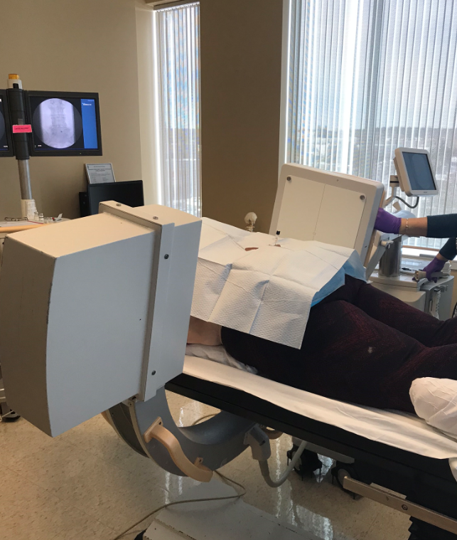
Lateral view

Slide 44
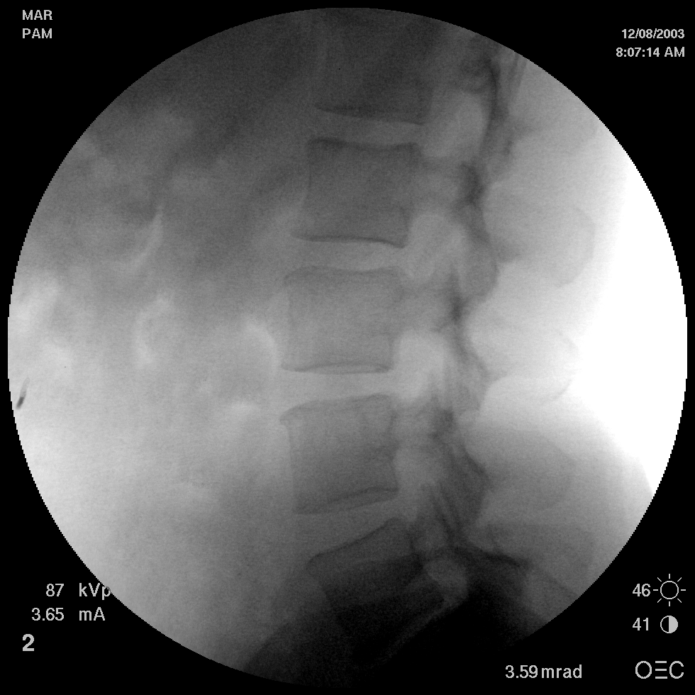

Slide 45
Let’s find these structures
vertebral bodies
pedicles, lamina, superior and inferior articular processes
transverse processes
spineous processes

Slide 46
VERTEBRAL BODIES

Slide 47
Disregarding everything else, for the moment,
trace the outline of each of the vertebral bodies.
Upon doing so, confirm the count.

Slide 48
L1

Slide 49
L1
L2

Slide 50
L1
L2
L3

Slide 51
L1
L2
L3
L4

Slide 52
L1
L2
L3
L4
L5

Slide 53
SUPERIOR ARTICULAR PROCESSES
LAMINA PEDICLES
INFERIOR ARTICULAR PROCESSES

Slide 54
From each vertebral body,
trace the pedicle
to the laminae, and
to the superior articular process and
to the inferior articular process.
On doing so, establish the location of the zygapophysial joints.

Slide 55
L1

Slide 56
L2

Slide 57
L3

Slide 58
L4

Slide 59
L5

Slide 60
TRANSVERSE PROCESSES

Slide 61
At each level,
find the transverse process.

Slide 62
L1
L2
L3
L4
L5

Slide 63
SPINOUS PROCESSES

Slide 64
L1
L2
L3
L4
L5

Slide 65
Contralateral Oblique view
Allows clear view of the ipsilateral lamina (side of needle entrance)
and the interlaminar opening
Needle tip visualization is better

Slide 66
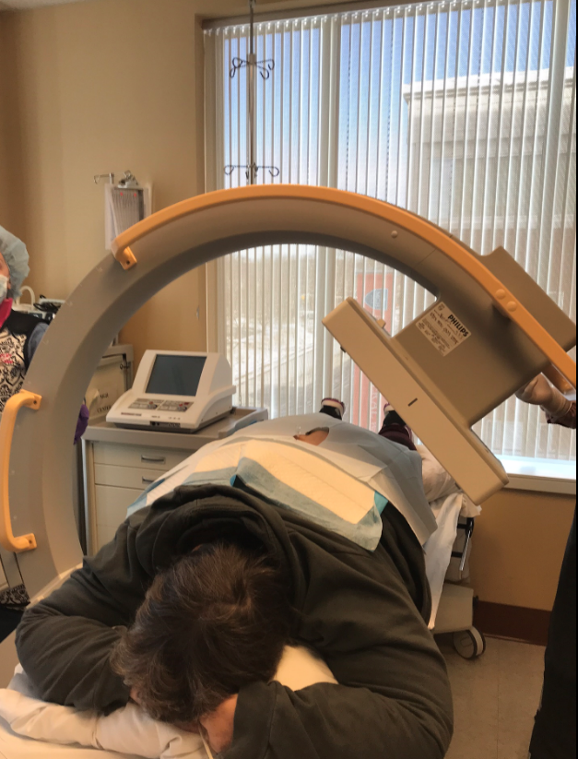
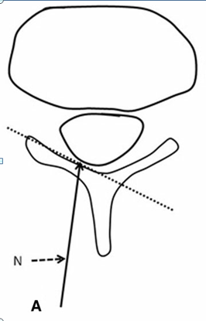
Contralateral oblique view

Slide 67
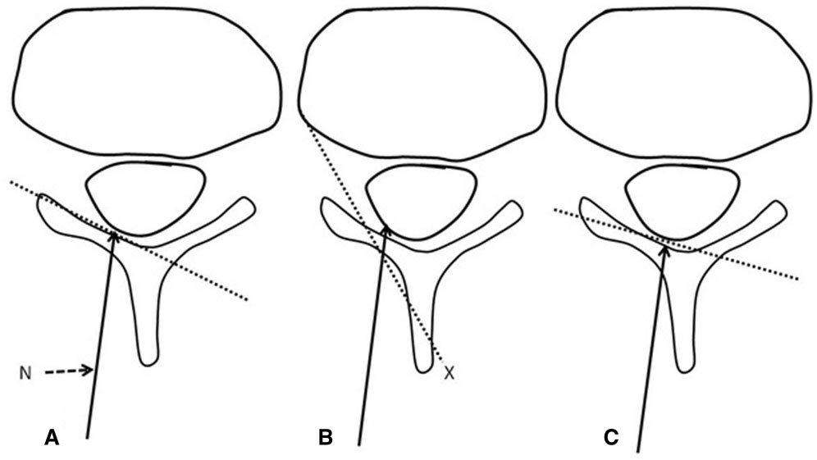
Contralateral Oblique view – optimal angle
A 45 degrees B 30 degrees C Overangulation
Jill et al. Pain Medicine, 17(5)

Slide 68
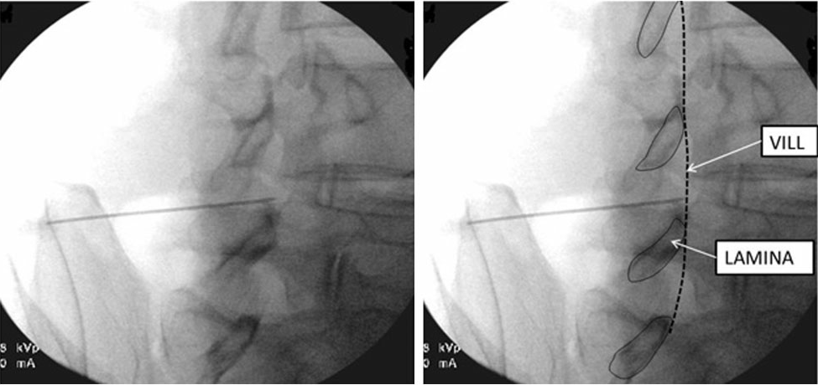
Contralateral Oblique view
VILL: ventral interlaminar line
Jill et al. Pain Medicine, 17(5)

Slide 69
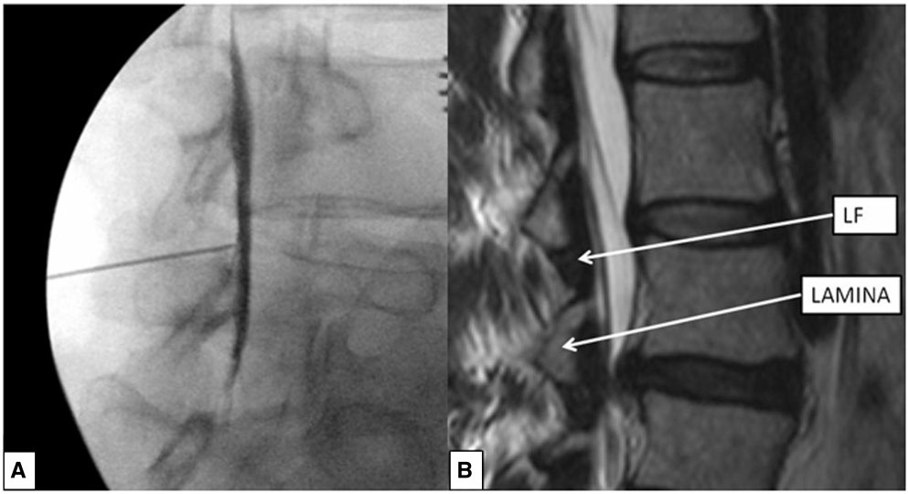
Contralateral Oblique view
Jill et al. Pain Medicine, 17(5)

Slide 70
Approaches to the lumbar epidural/intrathecal space

Slide 71
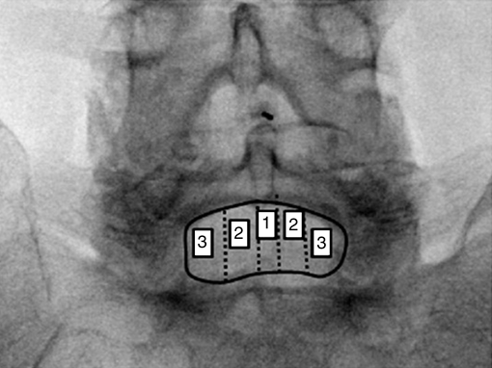
Perpendicular approach, coaxial technique
Jill et al. Pain Medicine, 17(5)

Slide 72
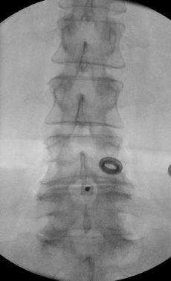
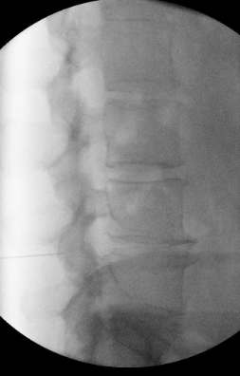
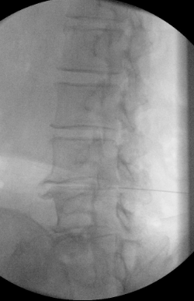
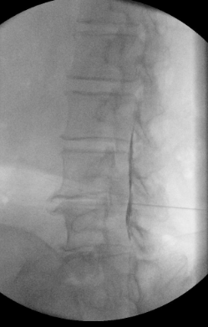
Perpendicular access, L4/5 interspace, left paramedian, coaxial technique
Achieve and maintain coaxial view of the needle in AP view while advancing the needle
Lateral view
Contralateral oblique view at 45 degrees
Contralateral oblique view at 45 degrees, contrast spread in epidural space

Slide 73
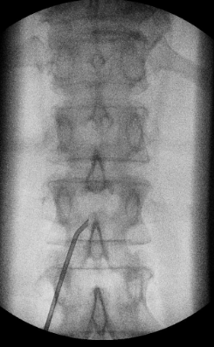
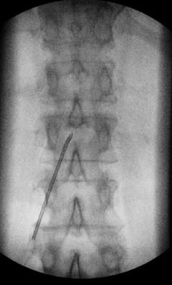
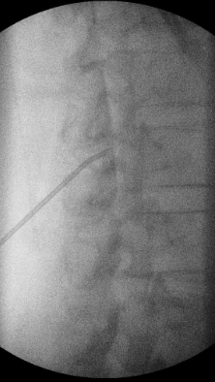
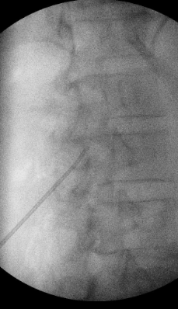
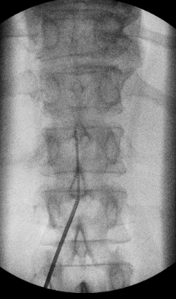
Shallow angle, paramedian approach
-- to reduce Kinking of wire/catheter
-- example taken from spinal cord stimulator lead placement
Touch lamina
Walk off lamina
Advance in contra-lateral
Oblique view
Into epidural space
Rotate needle to reduce entry angle
Thread lead in shallow angle

