Slide 1
Prone Positioning in the Acute Respiratory Distress Syndrome
C. Corey Hardin MD, PhD
April 23, 2020

Slide 2
Introduction
Hypoxemia and ARDS
Physiology of prone positioning
Benefit of prone ventilation in clinical trials
Complications, contraindications and duration
Prone positioning for awake patients

Slide 3
Introduction
Hypoxemia and ARDS
Physiology of prone positioning
Benefit of prone ventilation in clinical trials
Complications, contraindications and duration
Prone positioning for awake patients

Slide 4
Hypoxemia and ARDS
V/Q Mismatch
Shunt

Slide 5
“Lung Protective” Ventilation
V
o
l
u
me
Add PEEP
Limit Distending
Pressure
Pressure

Slide 6
Introduction
Hypoxemia and ARDS
Physiology of prone positioning
Benefit of prone ventilation in clinical trials
Complications, contraindications and duration
Prone positioning for awake patients

Slide 7
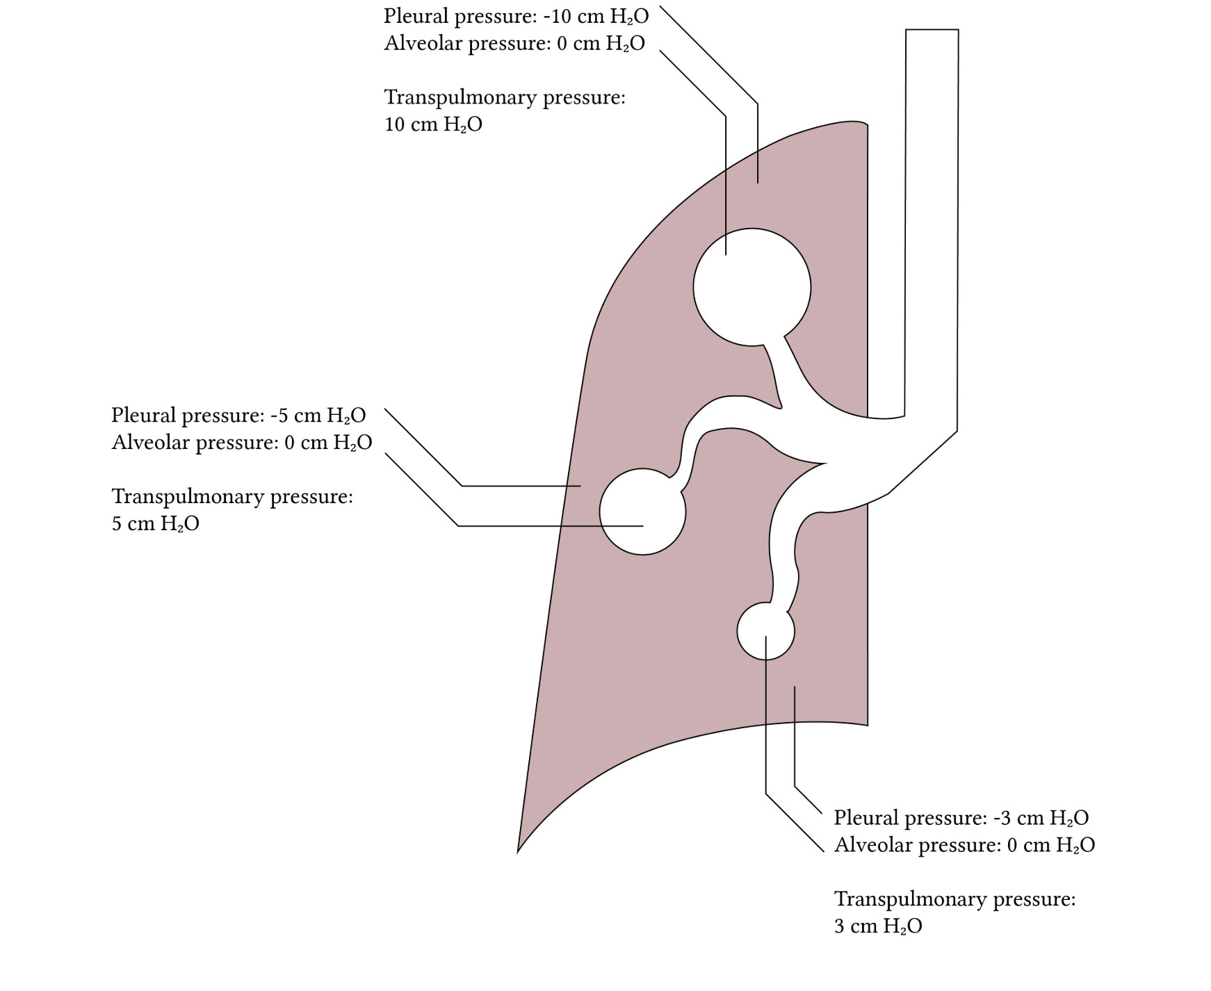
Gradients of pleural pressure

Slide 8
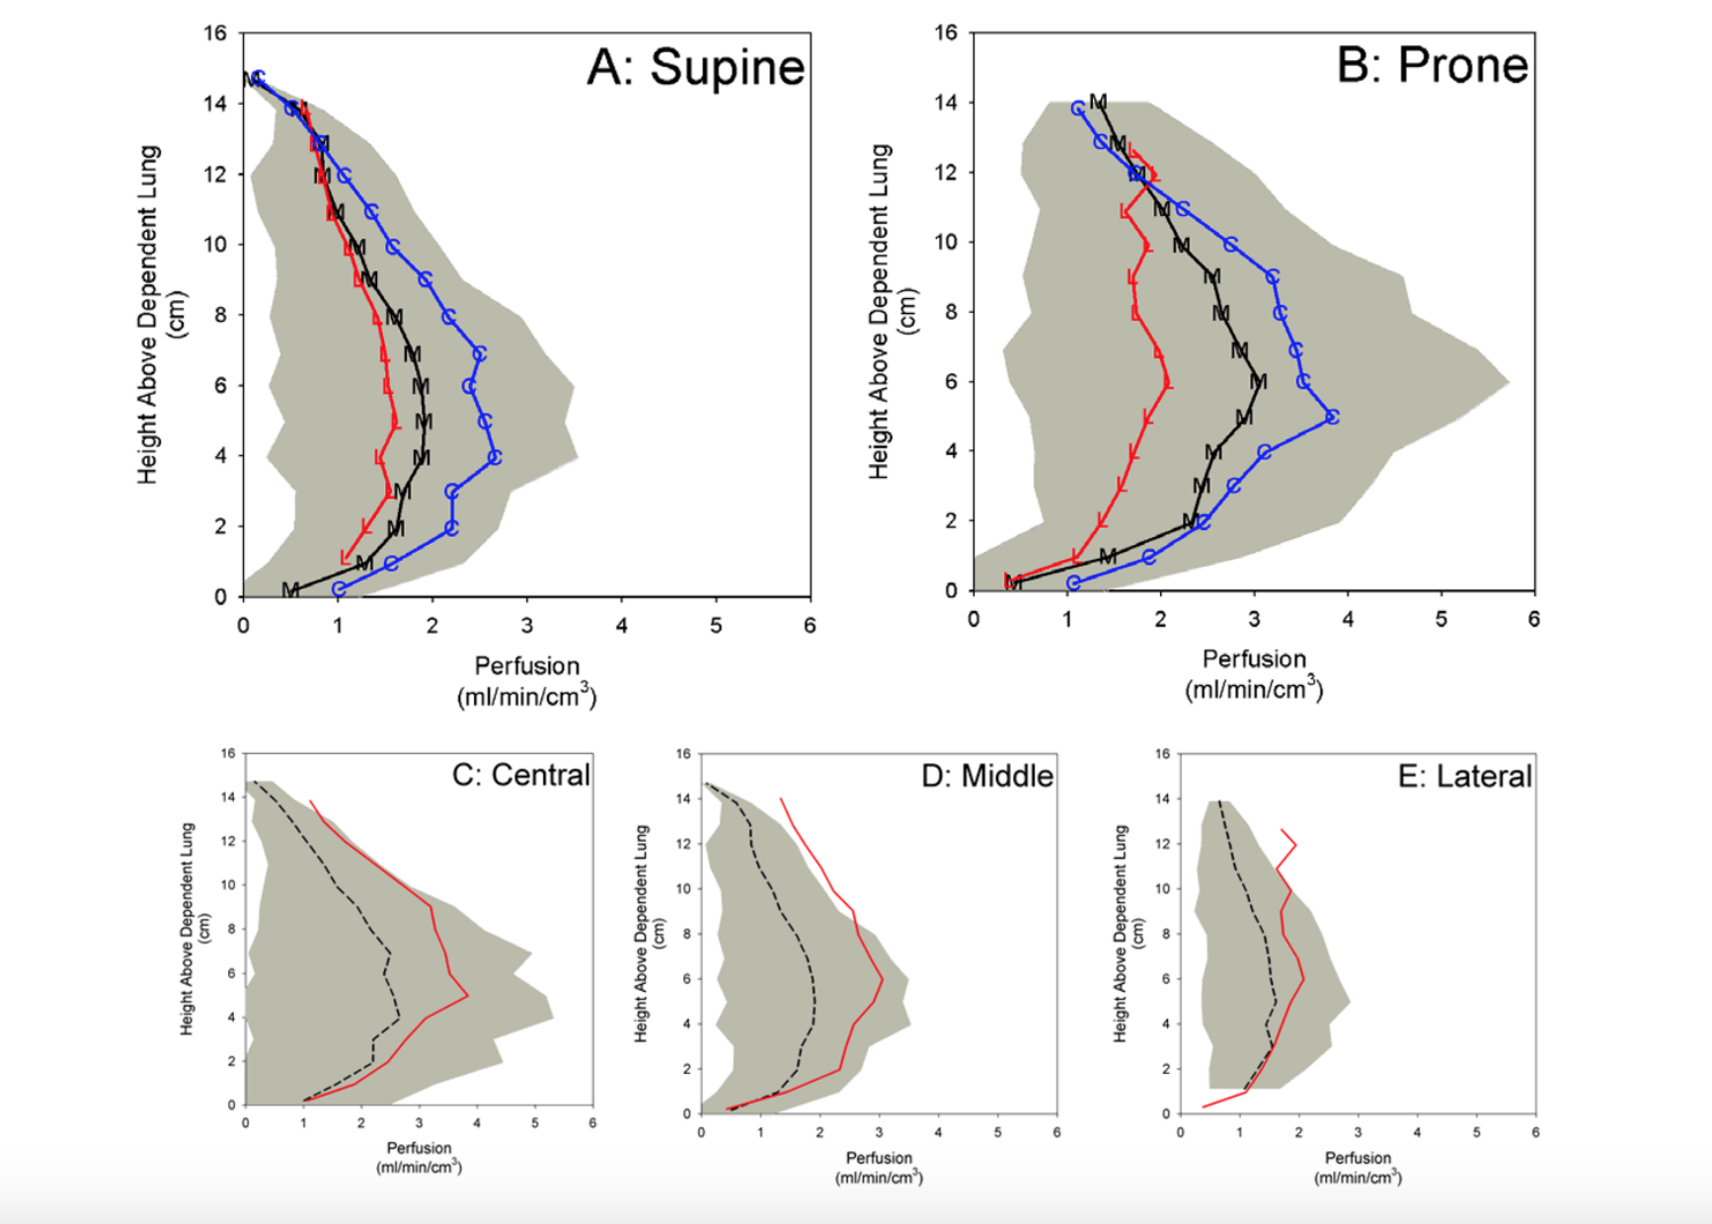
Gradients of Perfusion
Prisk JAP 2007

Slide 9
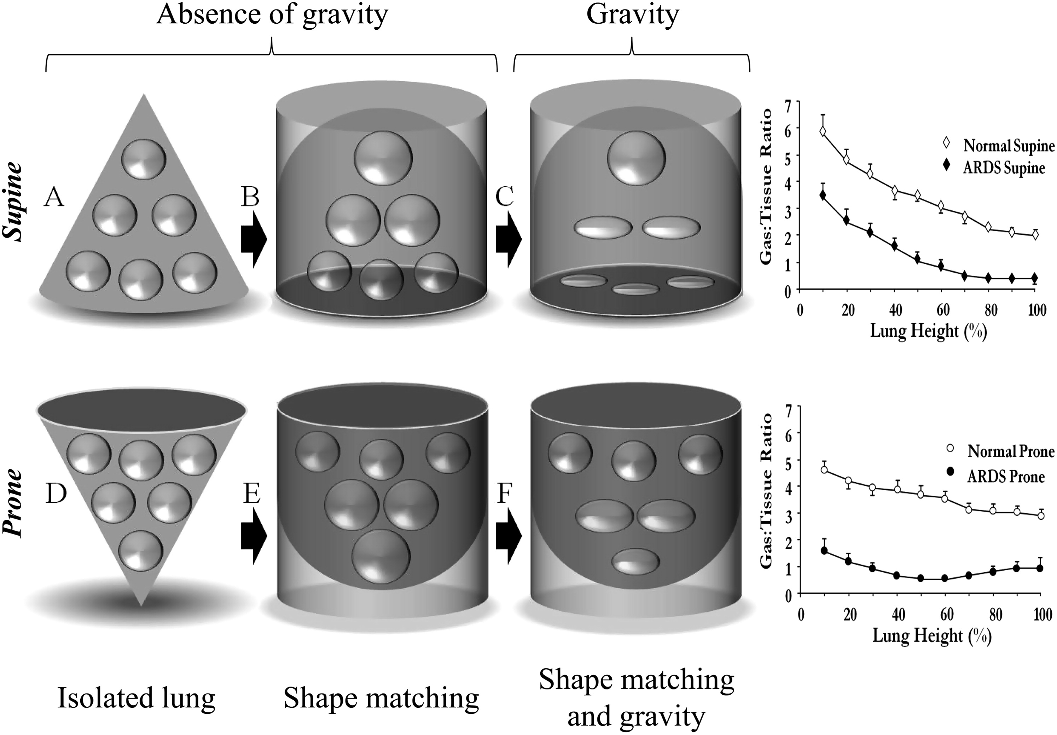
Gattinoni AJRCCM 2013

Slide 10
Physiology of prone - summary
Recruitment of posterior lung – decrease shunt
Recruitment of posterior lung with continued perfusion – improved V/Q
Mediatstinum supported by sternum
Less heterogenous inflation
Improved oxygenation with less overdistension

Slide 11
Introduction
Hypoxemia and ARDS
Physiology of prone positioning
Benefit of prone ventilation in clinical trials
Complications, contraindications and duration
Prone positioning for awake patients

Slide 12
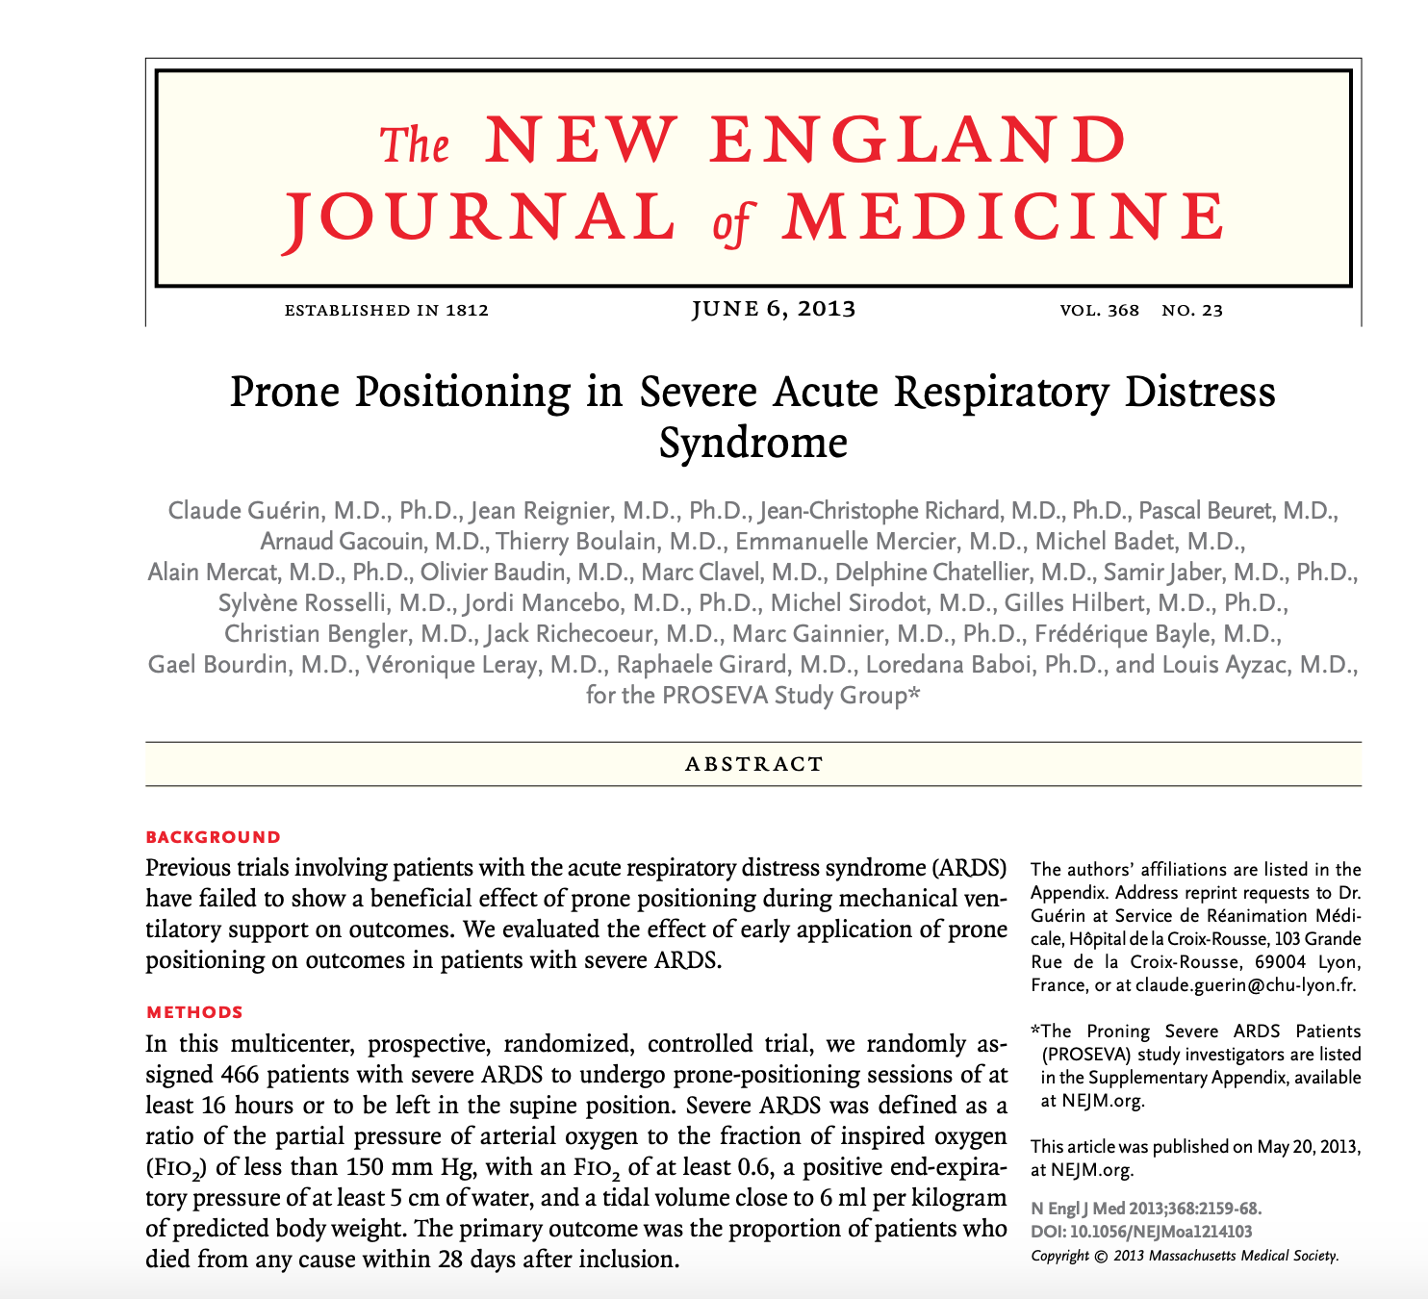

Slide 13
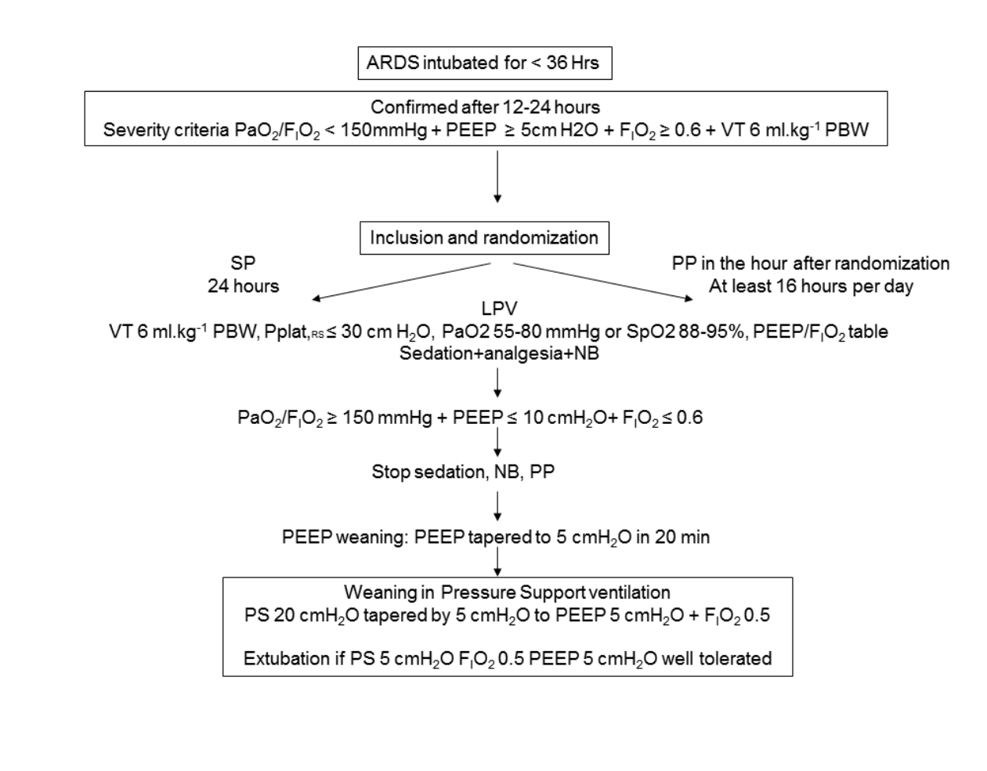

Slide 14
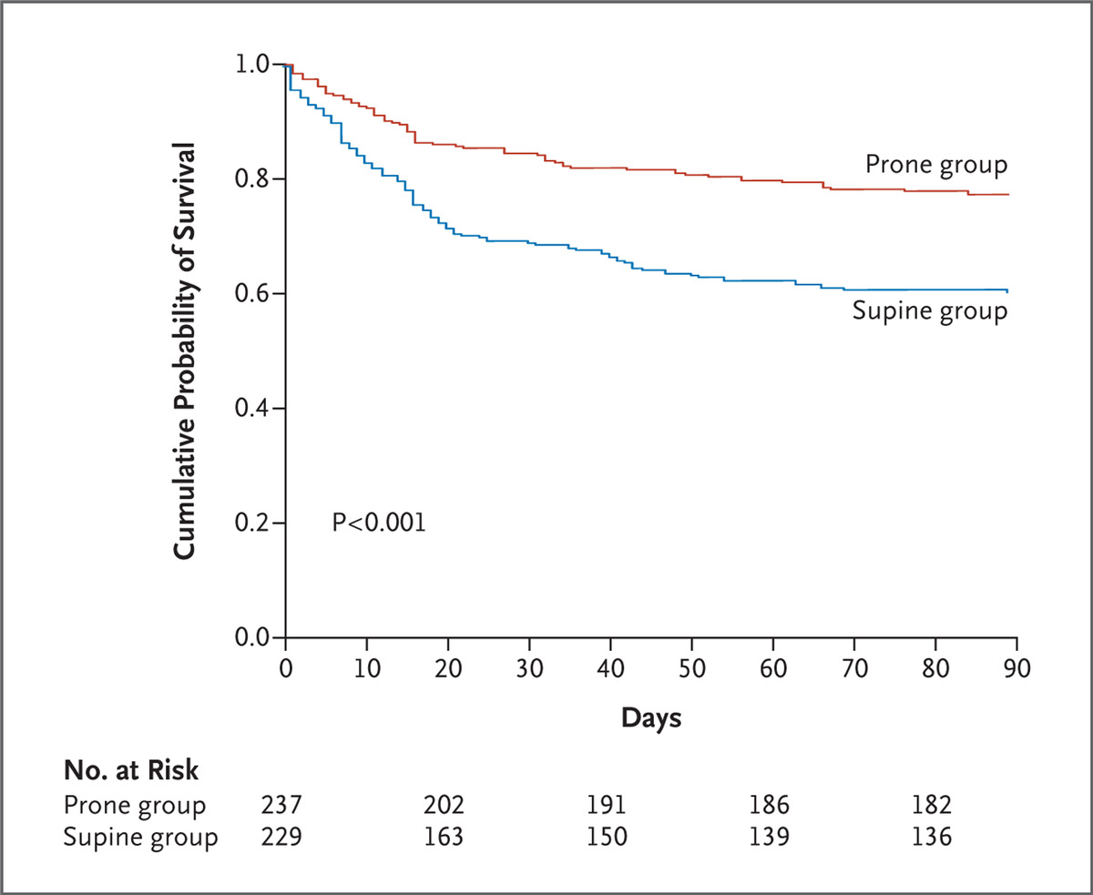
Guérin C et al. N Engl J Med 2013;368:2159-2168.
Kaplan–Meier Plot of the Probability of Survival from Randomization to Day 90.
Notes:
Figure 2. Kaplan–Meier Plot of the Probability of Survival from Randomization to Day 90.

Slide 15
Introduction
Hypoxemia and ARDS
Physiology of prone positioning
Benefit of prone ventilation in clinical trials
Complications, contraindications and duration
Prone positioning for awake patients

Slide 16
Contraindications and Complications
Few absolute contraindications: Unstable spine, unstable sternum
Pregnancy is not a contraindication
Lines not an absolute contraindication
Relative contraindications:
Severe hemodynamic instability
Acute dependence on vascular access catheters (risk/benefit)

Slide 17
Prolonged prone ventilation
Romero, J. Crit. Care, 2009

Slide 18
PEEP TITRATION
P:F < 150 on F_{I}O₂ > 0.6
Best PEEP by Tidal Compliance
ΔP = Pplat - PEEP
Best PEEP = lowest driving pressure
In event of tie, choose lowest PEEP at best driving pressure
Set PEEP = Best PEEP + 2cmH₂O (increased stability for turns)
Can be paired with recruitment maneuver if team considers appropriate
** Consider use of ARDSnet Low PEEP table if staff not available for Best PEEP
ARDSnet Low PEEP Table
ΔP < 15 cm H₂0 and P:F > 150 ??
Do not repeat Best PEEP!
PRONE VENTILATION
Leave at set PEEP
Do not re-titrate or lower for at least 24hrs after titration
(unless significant clinical change)
STOP
May repeat PEEP titration in prone position
Supine qam. Increase PEEP prior to supine
If P: F> 150 on PEEP < 8 cm H₂O in supine position, do not return to prone. Otherwise, return to prone.
yes
No
Decompensation

Slide 19
Introduction
Hypoxemia and ARDS
Physiology of prone positioning
Benefit of prone ventilation in clinical trials
Complications, contraindications and duration
Prone positioning for awake patients

Slide 20
Prone position in non-intubated patients
Scaravilli, J. Crit. Care, 2015

Slide 21
Prone position in non-intubated patients
Retrospective single center study
Prone on average 2 days after admit
2-4 hours average duration
Median 2 sessions per patient
2 procedures stopped due to patient discomfort
No complications
Scaravilli, J. Crit. Care, 2015

Slide 22
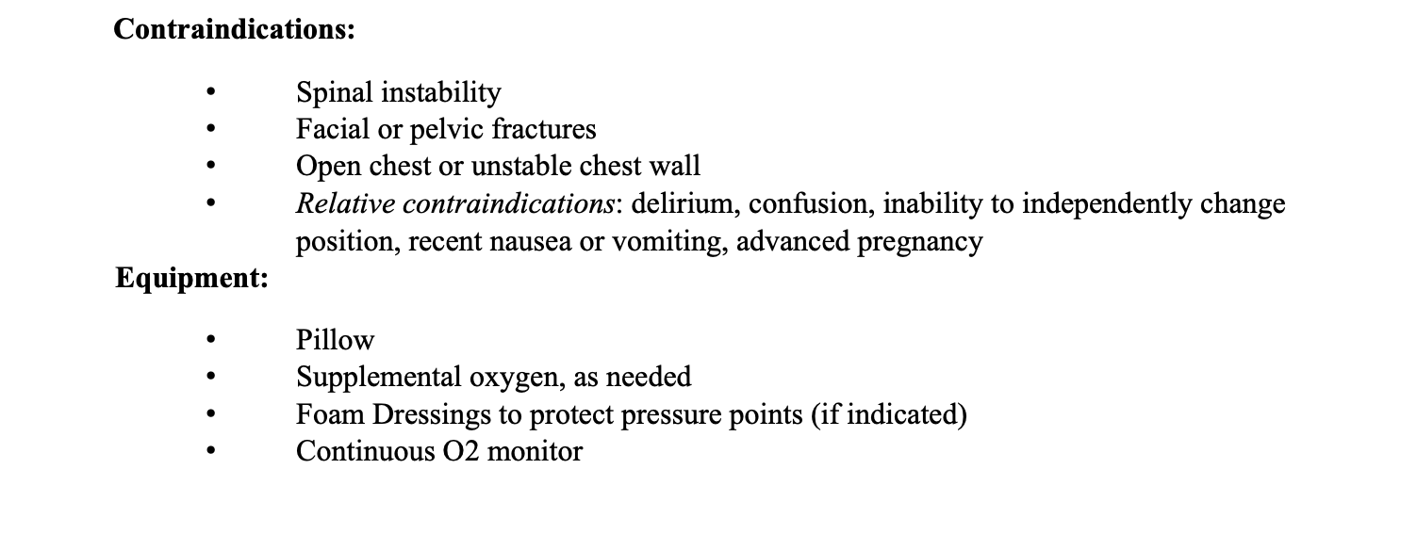
MGH Awake Prone Position Protocol
Initial prone – 1 hour on admit, “more often than not” thereafter
Rescue prone – increase by > 2L in O2 needed to maintain SpO2 > 90% -> 1 hour prone position
Monitoring: RR, SpO2

Slide 23
MGH Protocol for management of COVID-19:
http://apollo.massgeneral.org/coronavirus/wp-content/uploads/sites/78/2020/03/MGH-Critical-Care-of-COVID-19-Protocol.pdf
http://apollo.massgeneral.org/coronavirus/wp-content/uploads/sites/78/2020/03/Covid19_ICU_RX_SUMMARY_FIGURE.pdf
MGH Protocol for Prone Ventilation:
http://apollo.massgeneral.org/coronavirus/wp-content/uploads/sites/78/2020/03/Prone-Positioning-Guideline.clean-1.pdf
https://apollo.massgeneral.org/dept-medicine/wp-content/uploads/sites/5/2020/04/covid-19_mghPulm_pronePositioningForNon-Intubated.pdf

Slide 24
Questions?

